Slide 1

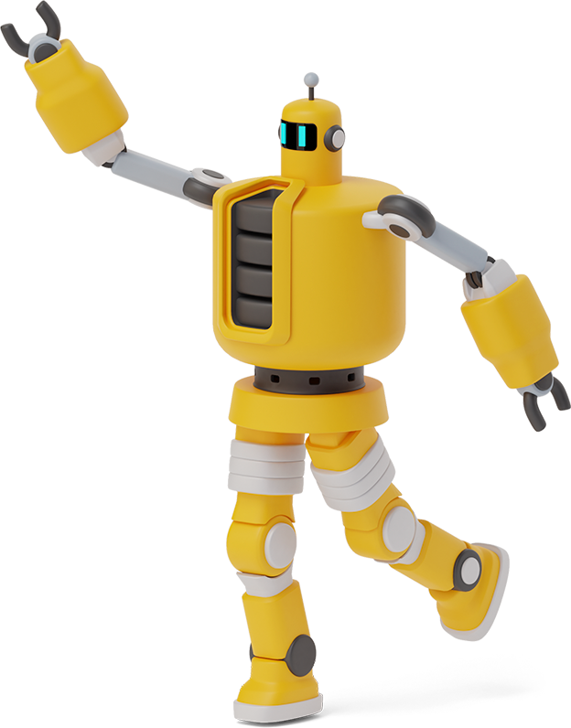
Python Playground

Slide 2
Roadmap
Homework Takeup
Lists
Tuples
1
3
5
2
4
6
Review of Past Class
List Methods
Conditionals

Slide 3
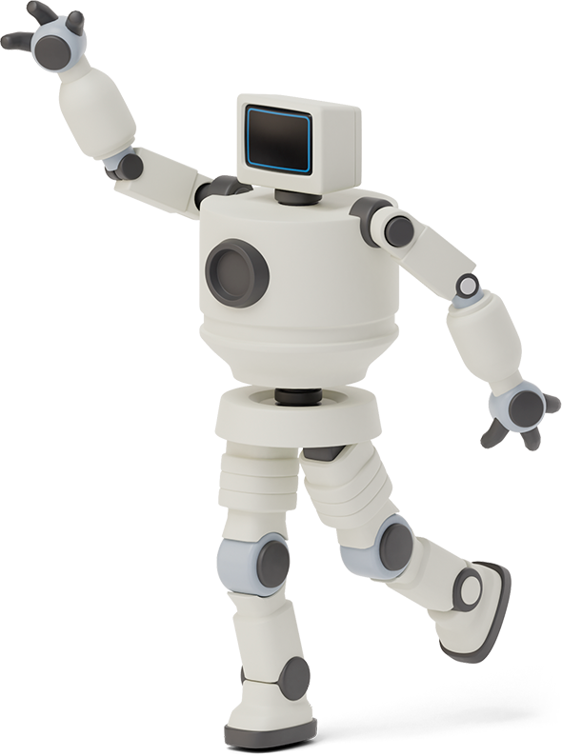

Homework Link
https://github.com/Asfandyar-Khan/PythonPlayground/blob/main/index.md
Contains all lectures and Google Colab notebooks
Contains homework which will be a word document
Does anyone have any homework questions?
New file – Python Project Ideas

Slide 4
Review of Last Week
Prior week’s homework questions
For Loops Review
Range() function
Lists
List methods

Slide 5
This week...
Take up Week 7 Homework
Review Lists
Review list methods
.append()
Index[] mechanism
Tuples
Conditionals

Slide 6
Let’s Review Lists

Slide 7
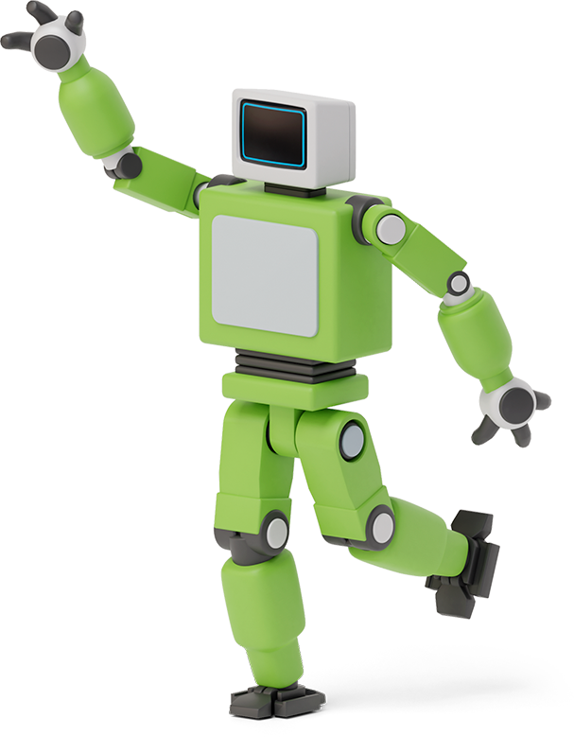


Lists – Data Structure
Lists
Lists are a data structure that is used to
collect data items
Can hold both integers and strings!
They are mutable (changeable)
Lists maintain a defined order
The first item is given priority
Then the second item, and so on...

Slide 8

Tuples – Data Structure
Tuples
Are a data structure that is used to collect data items
They are non-mutable (unchangeable)
Maintain a defined order
The first item is given priority
Then the second item, and so on...

Slide 9
Conditionals - If/Elif/Else
Conditionals let your program make decisions and choose different paths!
If: The starting point – “if this condition is true, then do this”
elif: Short for “else if”. Checks another condition only if the previous one was false
else: “If none of the above conditions is true, then do this instead”

Slide 10
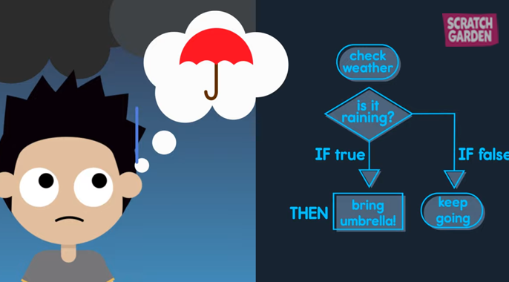
Conditionals - If/Elif/Else

Slide 11
Conditionals - Operators
Conditions are built using comparison operators:
== (equal to)
!= (not equal to)
> (greater than)
< (less than)
>= (greater than or equal to)
<= (less than or equal to)

Slide 12
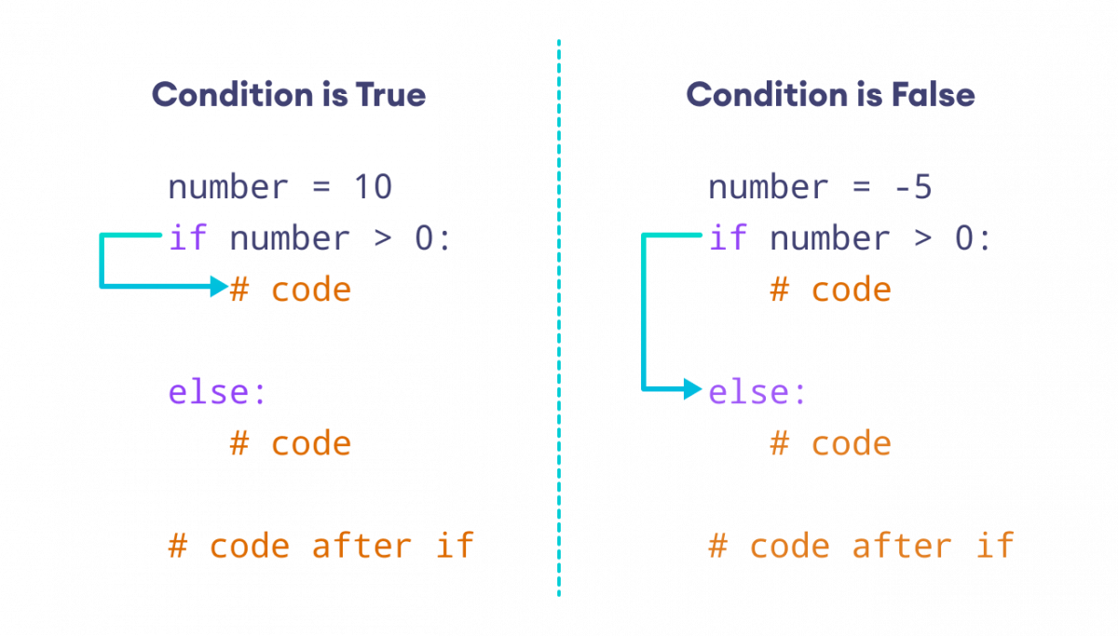
Conditionals - Syntax

Slide 13
Conditionals - Example
weather = "raining"
if weather == "sunny":
print("Wear sunglasses! 😎")
elif weather == "raining":
print("Don't forget your umbrella!☔")
else:
print("Have a great day! 🙂")
# This would print: "Don't forget your umbrella! ☔"

Slide 14
Thanks!
Any questions?

